Slide 1

Basic Bitcoin Tech: Securing your Bitcoin
Host - SimplestBitcoinBook w/ PortlandHODL

Slide 2
Overview -
What Bitcoins Are
The Private Key
Custody (Ownership Types)
Custodial
Self-Custodial
Types of security
Physical
Software
Social
Hardware (Cold)
Software (Hot)

Slide 3
What are Bitcoins?
bitcoins are Data
bitcoins are the unit of account on the timechain.
bitcoins are represented as the number of ‘satoshis’ in a UTXO (sent but not spent)
UTXOs can be combined or split up.
2. Data storage
bitcoins are stored across the Bitcoin network of nodes.
This is not a problem because even though the bitcoins are stored across thousands of computers, those bitcoins all have a lock on them that is impossible to crack without the key.
3. Spending
All bitcoins have a lock on them.
This lock in most cases needs the private key.
Without the key the bitcoins don’t move and can’t be spent, so be sure to secure the private key!

Slide 4
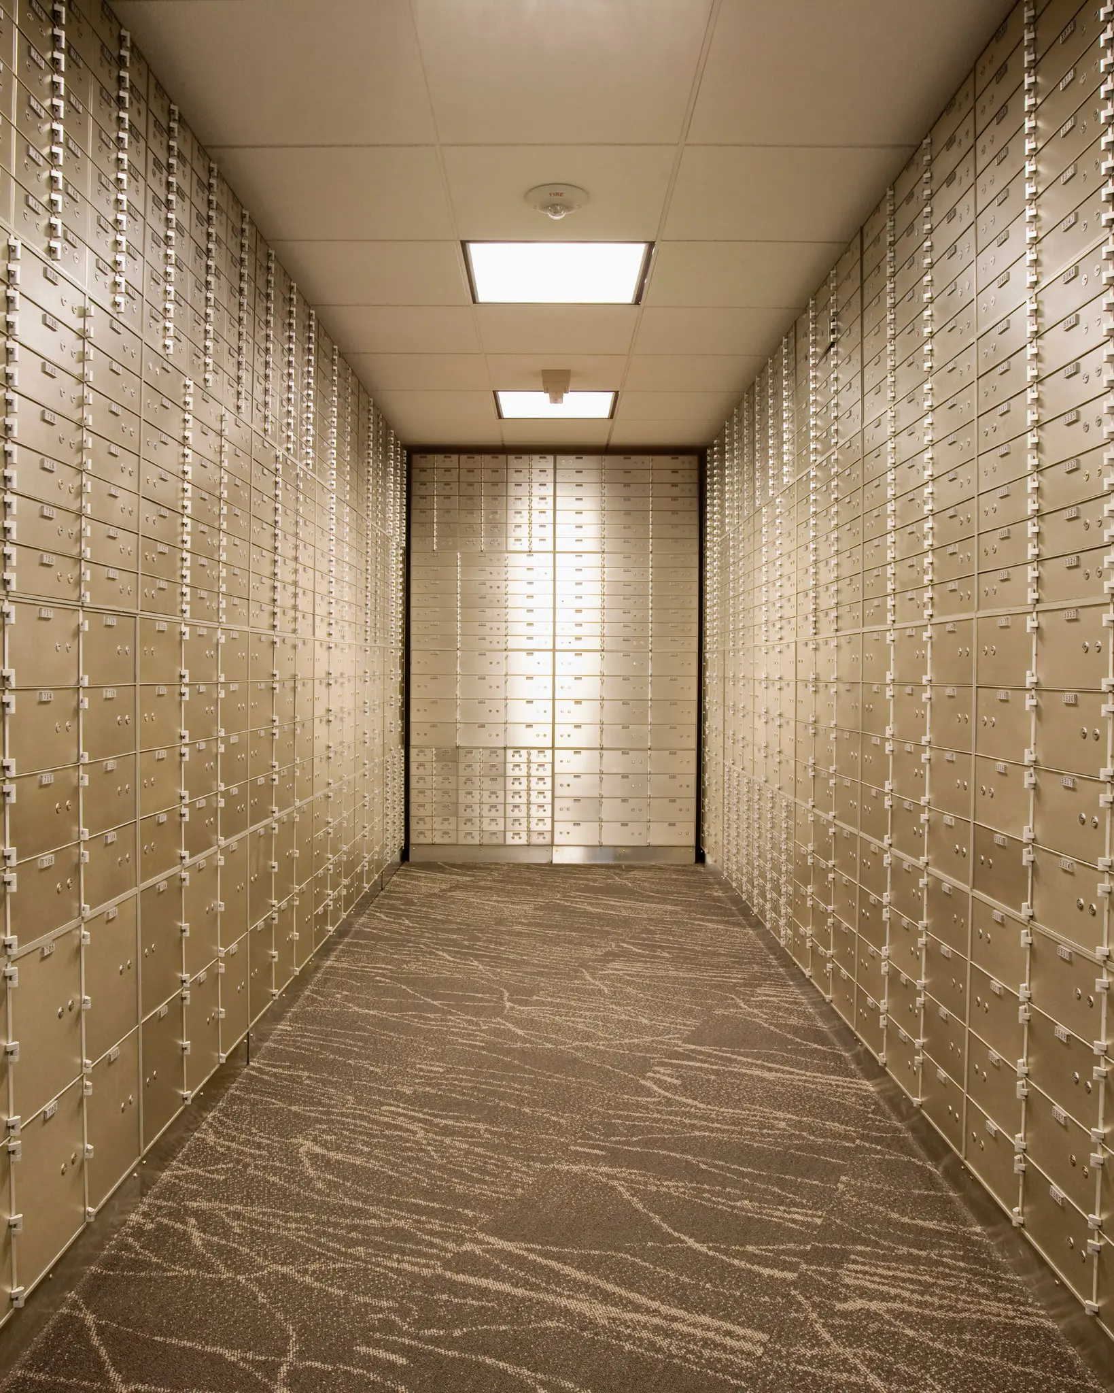
The timechain visualized - An analogy
One can imagine an address as a safe deposit box on a wall of 2^256 safe deposit boxes.
Each safe deposit box has a keyhole and a slit to deposit into (if bitcoins were physical).
Anyone can put bitcoins into an address (box) by passing them through the slit on the box, but the slit is so small it’s impossible for anyone to take anything out of the box unless they have the key. This is where privacy is involved.
The only way for someone to get into that box and spend the bitcoins (transfer them to another box) is to have the key to the safe deposit box. This is where security is involved.

Slide 5
THE PRIVATE KEY - DO NOT SHARE!
The private key is the code/password/key needed to spend bitcoins from a specific address.
This password is up to and should be 2^256 bits long.
It is often translated to a set of 12 or 24 words, known as a seed phrase.
ALWAYS SECURE THIS KEY AND NEVER SHARE IT WITH ANYONE EVER! WHOEVER HAS IT CAN SPEND YOUR BITCOIN
Visualized - If a bitcoin private key was a real key it would be roughly this long:

Slide 6

How many keys are there?
115,792,089,237,316,195,423,570,985,008,687,907,853,269,984,665,640,564,039,457,584,007,913,129,639,936 - So there are surely enough digital locks and keys for everyone for a very long time!
There are more possible bitcoin keys than atoms in the known universe. (6×10^79 atoms)

Slide 7
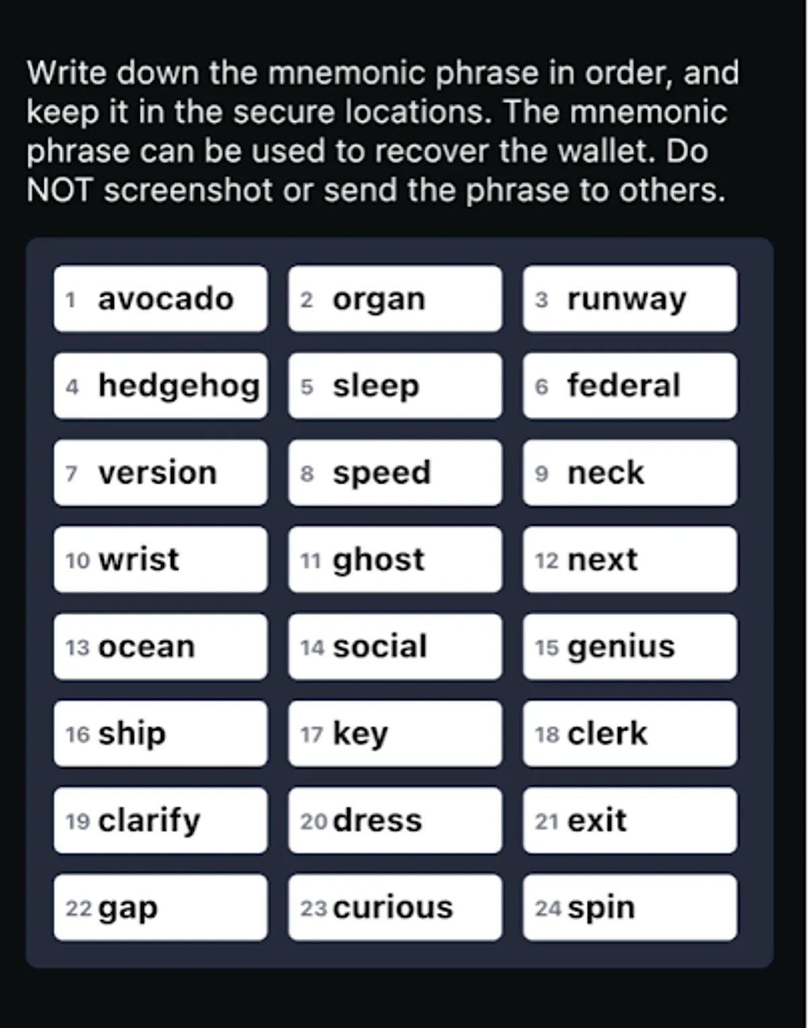
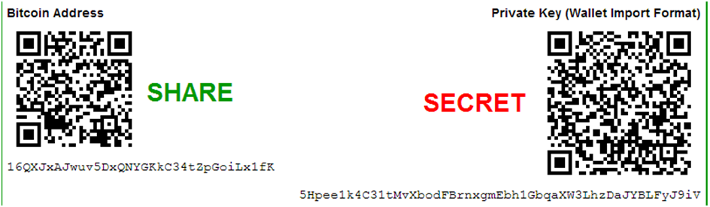
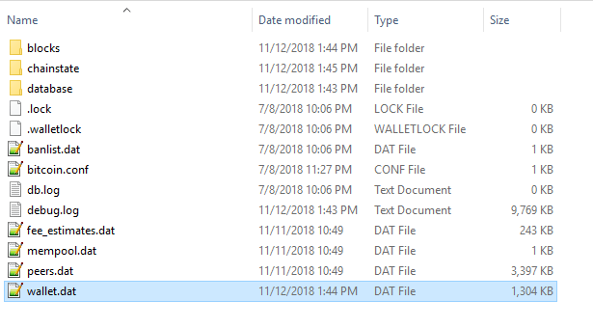
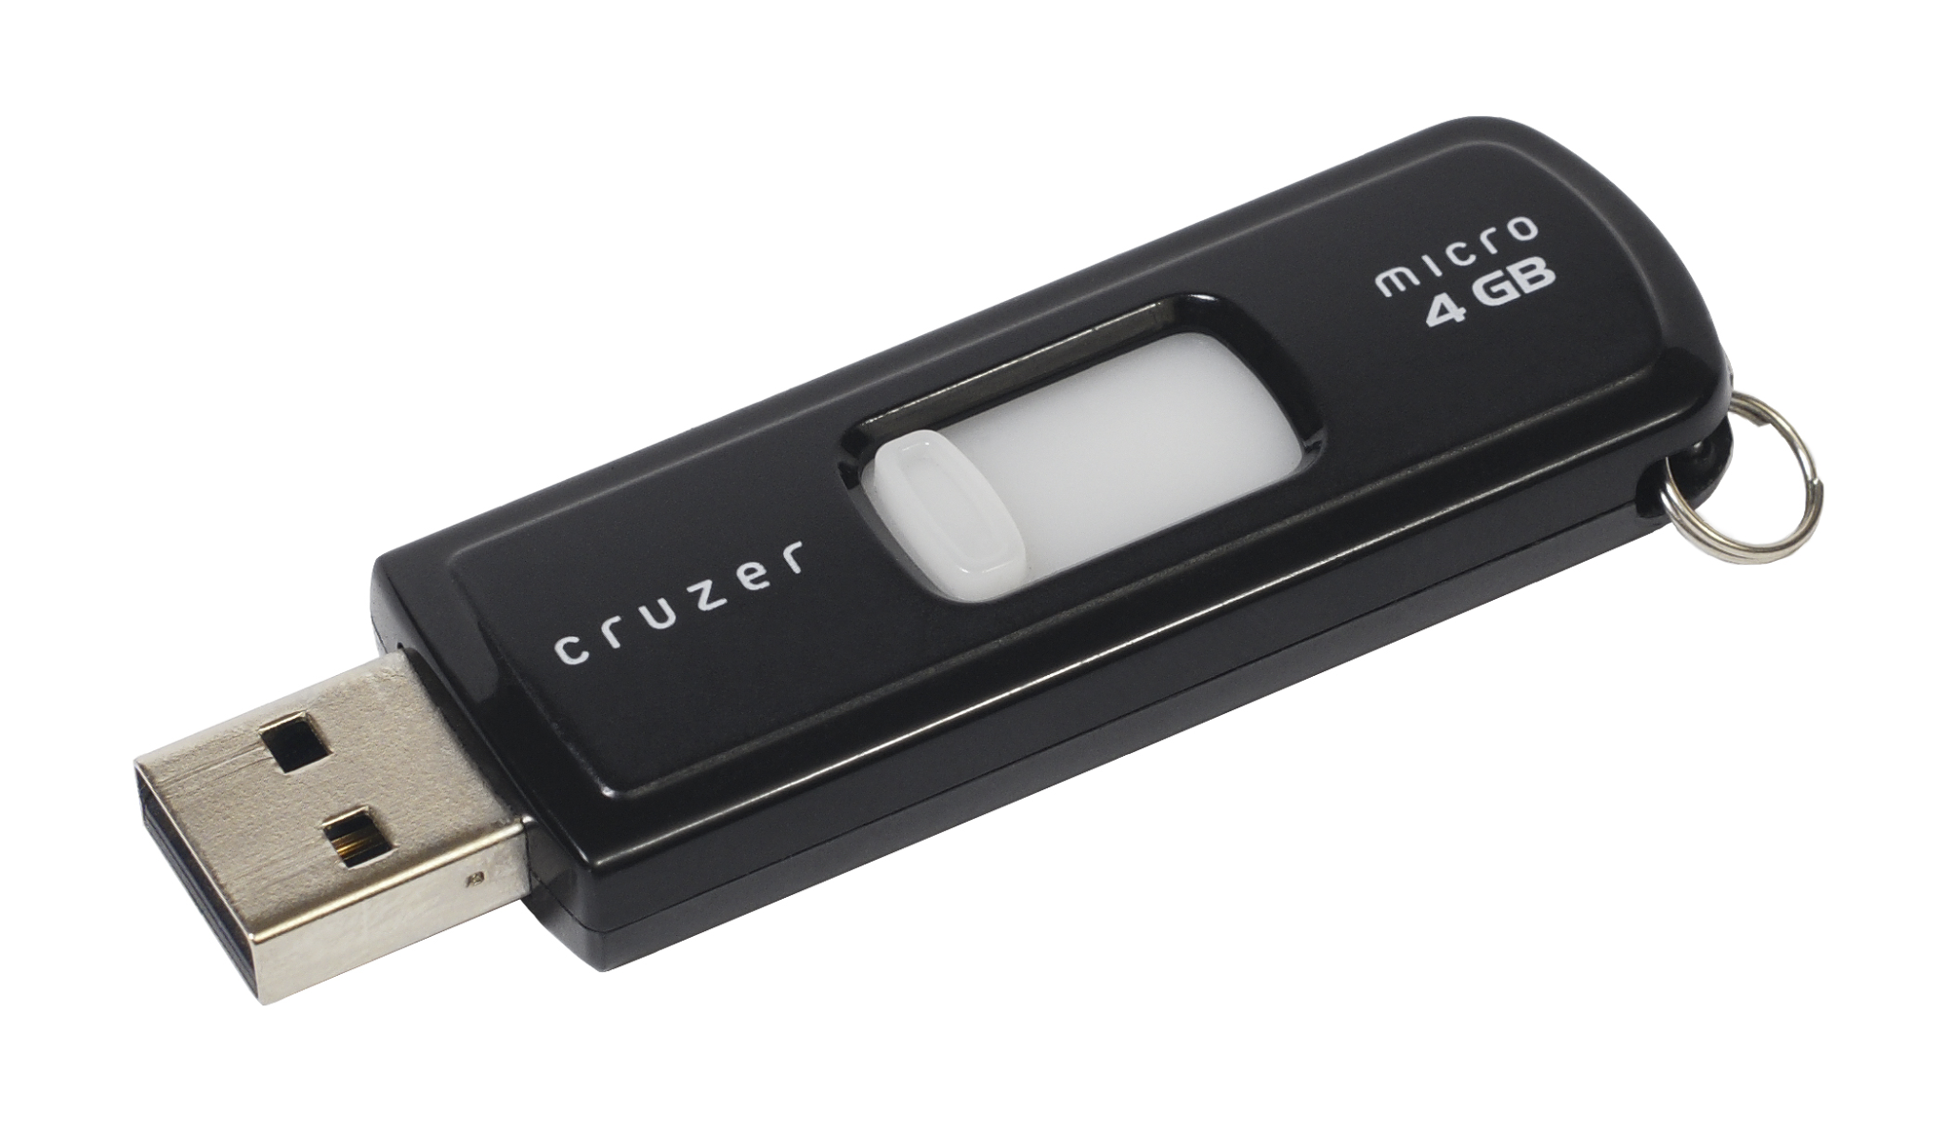
Types and Forms of Private Keys
More Common
Less Common
12/24 Word Seed Phrase
Wallet File (xpriv/HD)
WIF - Paper Wallet Private Key

Slide 8
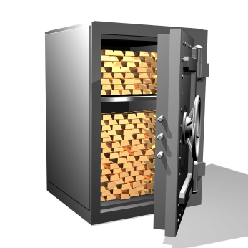
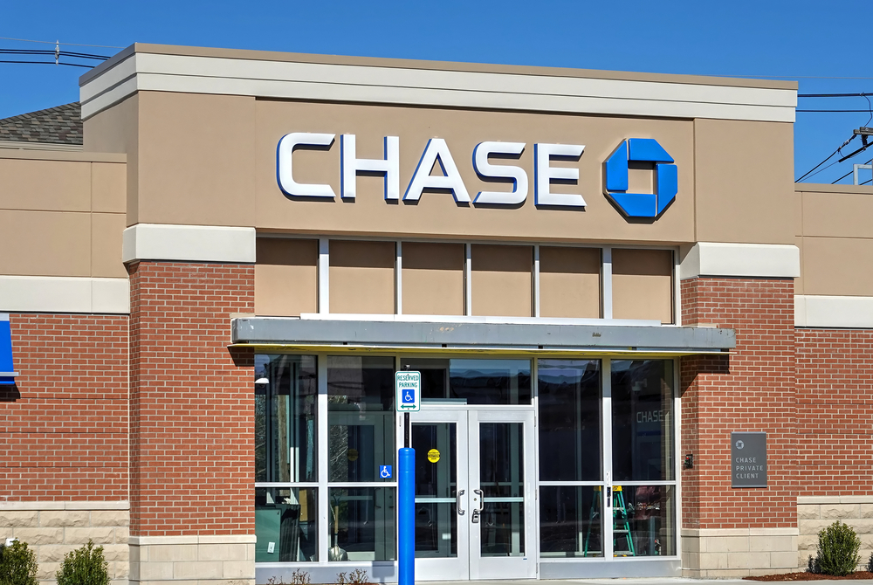
Custody - Who owns the keys owns the coins
In Bitcoin possession is ten tenths of the law. You either have your keys or you don't.
SELF-CUSTODY - You have your keys, and thus you own your own bitcoin.
CUSTODIAL - The ‘bank’ or the exchange has the keys, and the bitcoin

Slide 9
Pros and Cons
Self-Custody
Pros
Ultimate control of your money
No counterparty risk
Cons
You lose the key you lose the bitcoins
Custodial
Pros
You won’t lose access because of a lost ‘password’
Cons
Complete loss of funds if insolvent
Custodian is hacked or or loses keys
Potential to be locked out of your funds due to regulatory capture

Slide 10
SECURITY

Slide 11
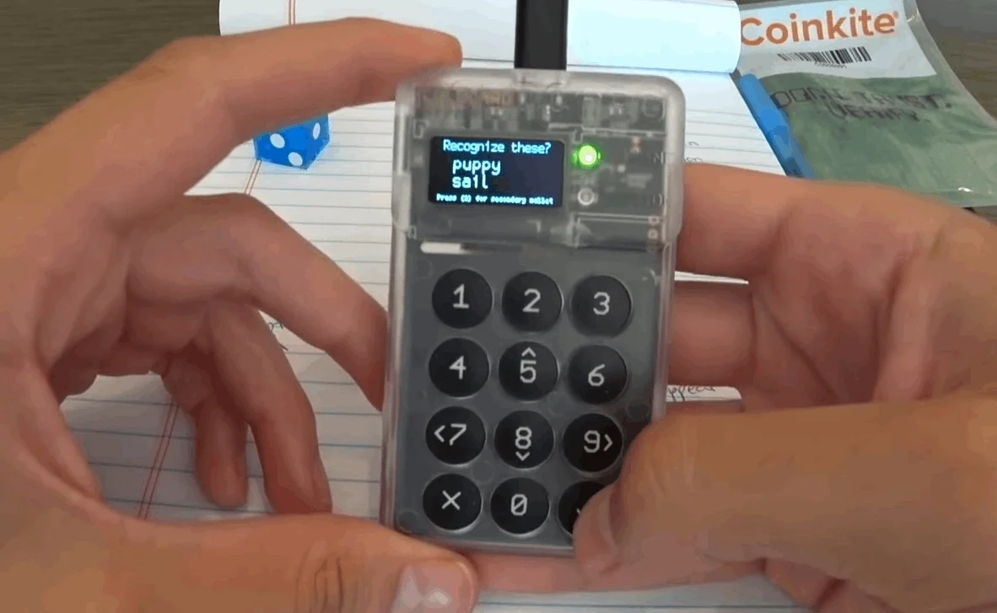
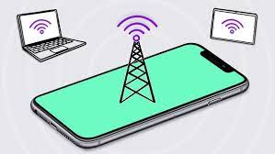
Hot vs Cold Storage (Signing Device)
HOT WALLET - Device is connected to the internet and/or is not air-gapped.
COLD STORAGE uses an air-gapped method to store and secure your seed phrase and sign transactions

Slide 12
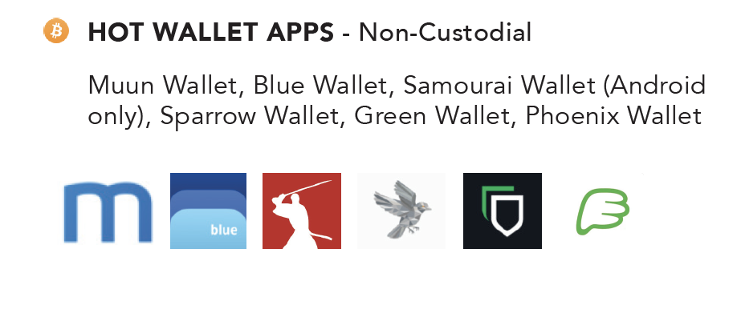
These apps are available on smartphones or desktop computers.
They are best used as ‘spending’ wallets for smaller amounts of bitcoin.

Slide 13
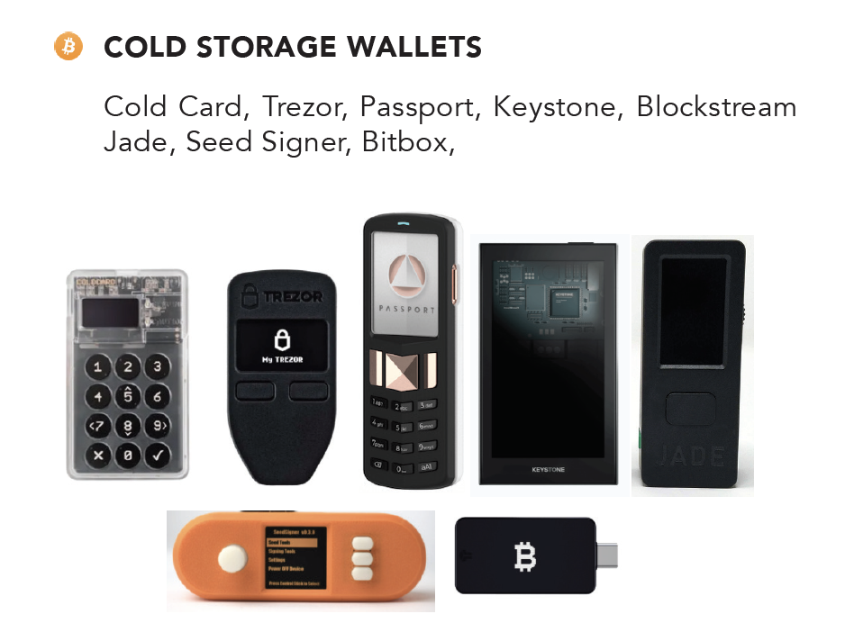
.*ALWAYS purchase your cold storage signing device new and direct from the manufacturer, to be certain it has not been tampered with.
.

Slide 14
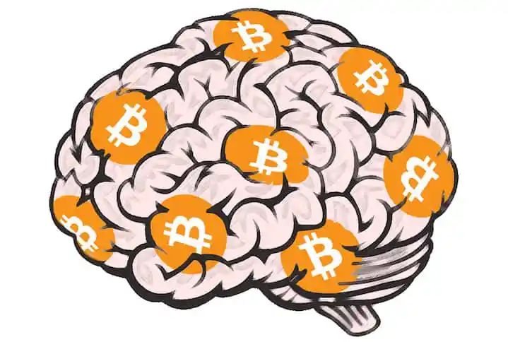
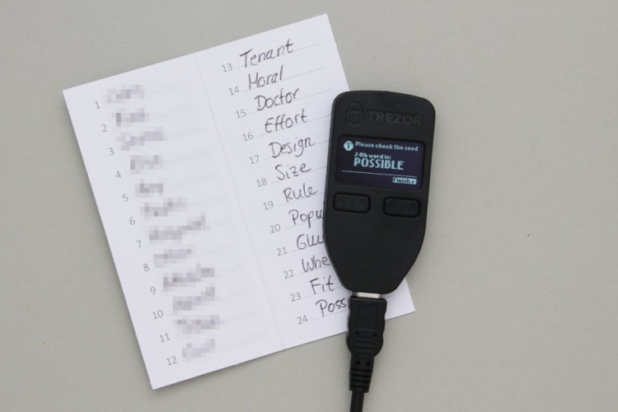
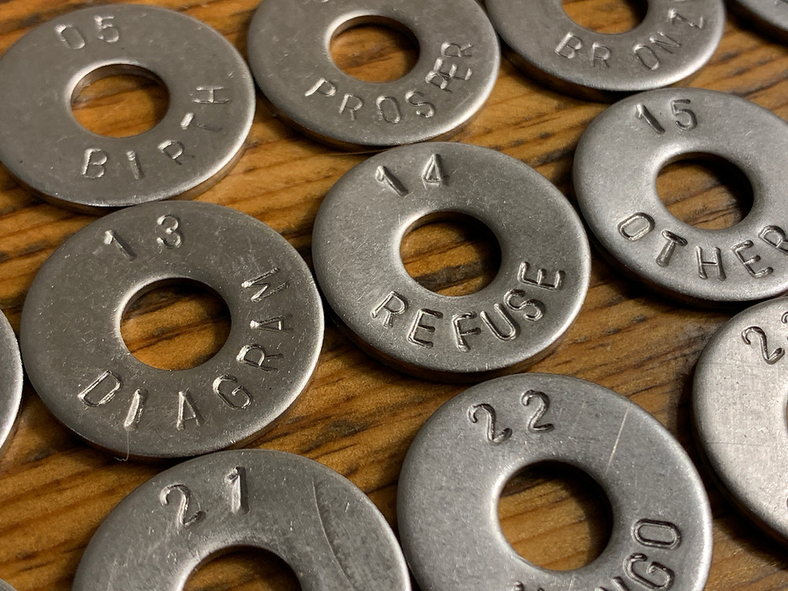
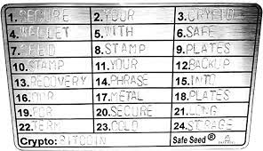
Physical Security - It’s all about the backup!
Washers are good - Must keep the order intact
Plates are excellent - Must be perfectly legible
Paper Works - Sub Optimal

Slide 15
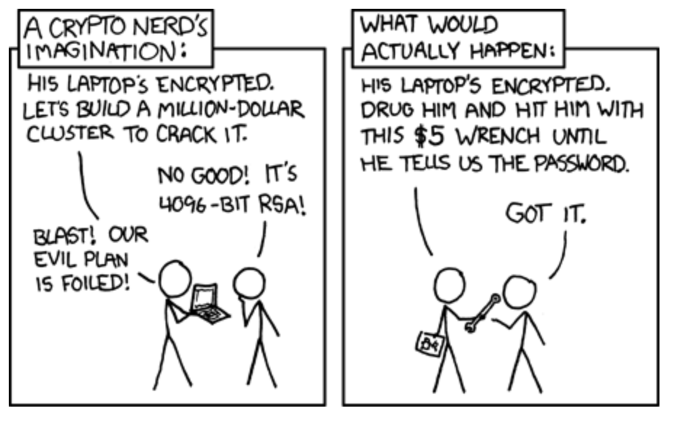
Social - DONT TALK ABOUT THE SIZE OF YOUR BITCOIN STACK!

Slide 16
Thanks for listening!
Let us know what we can do better.
Anything incorrect? Leave a comment.

